Slide 1
Class 20
FTAs and Other Trade Deals by
Alan V. Deardorff
University of Michigan
2020
PubPol/Econ 541

Slide 2
Outline
FTAs in general
North America
  NAFTA
  USMCA
Recent efforts and deals
  Africa
  EU & other
  China & other
  UK & other
  US & other

Slide 3
FTAs in General
Types
  Free Trade Agreement (FTA)
    Zero tariffs on (most) imports from partners
    Unequal tariffs on imports from outsiders
    Rules of origin (ROOs)
  Customs Union
    Zero tariffs on imports from partners
    Common external tariffs on outsiders
    No need for ROOs
  Common Market
    Customs Union plus other free movement

Slide 4
FTAs in General
Proliferation: Now more than 300, involving a significant fraction of possible country pairs
Most are FTAs
WTO reports all as Regional Trade Agreements (RTAs), though many include distant countries

Slide 5
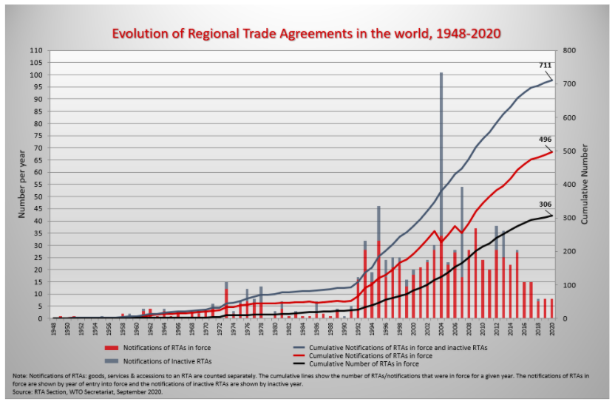
FTAs
Types
  Free Trade Agreement (FTA)
    Zero tariffs on (almost) all partner exports
    Unequal tariffs on imports from outside
    Necessary rules of origin (ROOs)
  Customs Union
    Zero tariffs on partner exports
    Common external tariffs
    No need for ROOs
  Common Market
    Customs Union plus free other free movement
Source: WTO
Notes:
https://www.wto.org/english/tratop_e/region_e/region_e.htm

Slide 14
Pause for Discussion

Slide 15
  Questions
Why are ROOs necessary in FTA but not in Customs Union?

Slide 16
NAFTA
What it was
  An FTA between US, Canada, and Mexico
  Went into effect Jan 1, 1994
Effects
  Trade
  Wages
  Employment
  Supply chains
  Consumers

Slide 17
NAFTA Effects
Trade
  Grew massively across N. America
  US bilateral trade with Mexico became deficits: US imports > US exports
  Supply chains, especially in autos, extended across North America

Slide 18
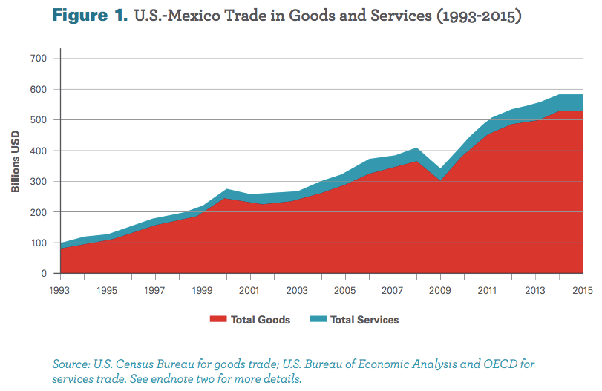
From: Wilson, Christopher, Growing Together: Economic Ties between the United States and Mexico, Wilson Center, March 2017.

Slide 19
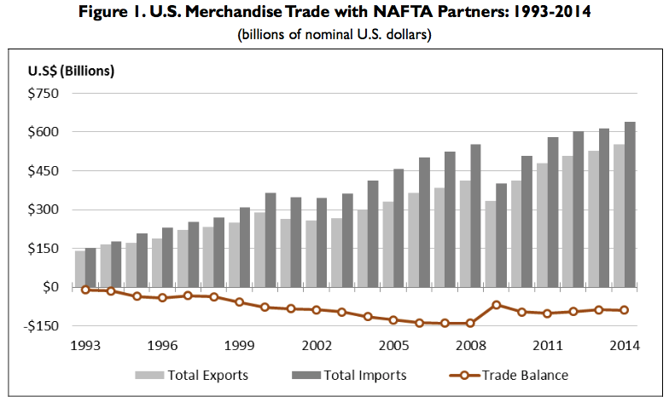
Source: Congressional Research Service (2015)

Slide 20
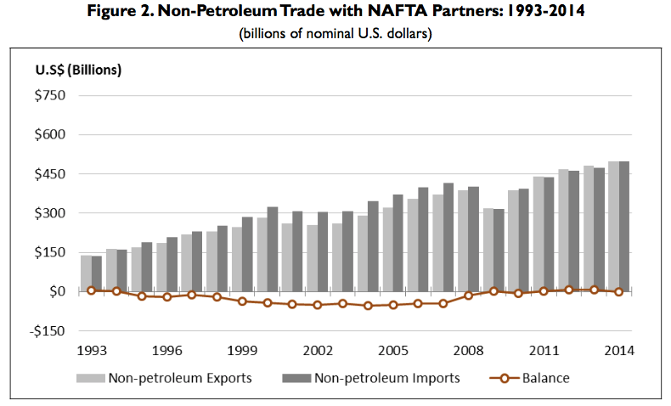
Source: Congressional Research Service (2015)

Slide 21
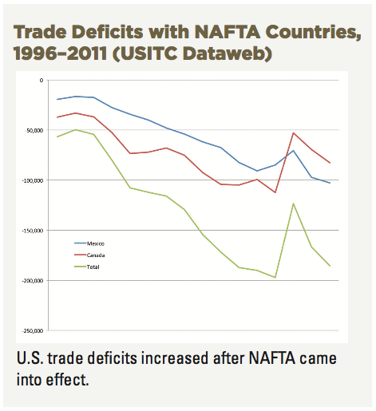
Source: AFL-CIO, “NAFTA at 20”

Slide 22
NAFTA Effects
Wages
  Fell in Mexico
  No effect on average in US

Slide 23
Real Wages Plummeted!
What Happened: Mexico
NAFTA
Peso Crisis

Slide 24
Real Wage: No Change
What Happened: U.S.
NAFTA
Peso Crisis

Slide 25
NAFTA Effects
Employment
  No effect on overall US employment or unemployment
  Pockets of disruption across US

Slide 26
Unemployment: No effect (or fell)
What Happened: U.S.
NAFTA
Peso Crisis

Slide 27
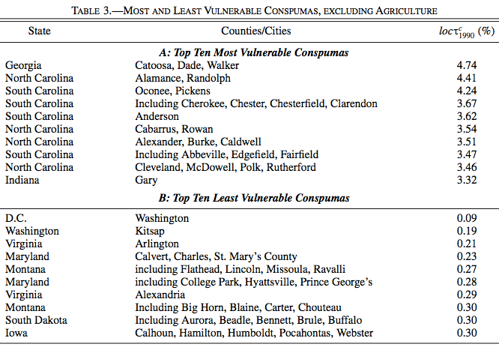
(Consistent Public-Use Microdata Areas)
Source: Hakobyan and McLaren (2016)

Slide 28
NAFTA Effects
Supply chains
  US manufacturing moved inputs to low-cost locations across N. America

Slide 29
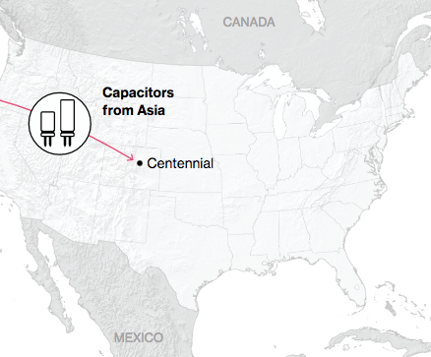
NAFTA and the Auto Supply Chain
Black, Diamond, and Merrill, “One Tiny Widget’s Dizzying Journey Shows Just How Critical Nafta Has Become,” Bloomberg, February 2, 2017.

Slide 30
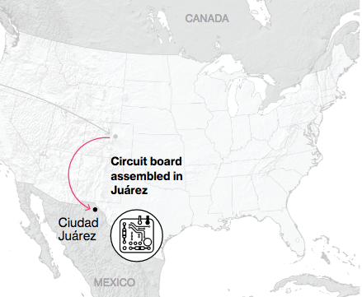
NAFTA and the Auto Supply Chain
Black, Diamond, and Merrill, “One Tiny Widget’s Dizzying Journey Shows Just How Critical Nafta Has Become,” Bloomberg, February 2, 2017.

Slide 31
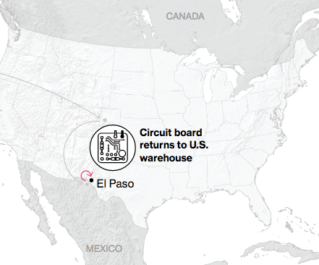
NAFTA and the Auto Supply Chain
Black, Diamond, and Merrill, “One Tiny Widget’s Dizzying Journey Shows Just How Critical Nafta Has Become,” Bloomberg, February 2, 2017.

Slide 32
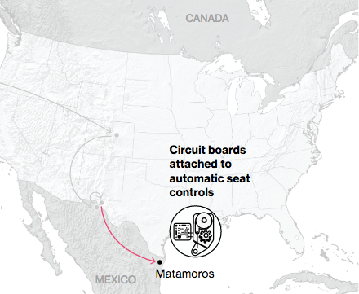
NAFTA and the Auto Supply Chain
Black, Diamond, and Merrill, “One Tiny Widget’s Dizzying Journey Shows Just How Critical Nafta Has Become,” Bloomberg, February 2, 2017.

Slide 33
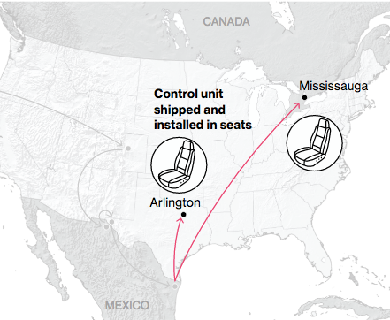
NAFTA and the Auto Supply Chain
Black, Diamond, and Merrill, “One Tiny Widget’s Dizzying Journey Shows Just How Critical Nafta Has Become,” Bloomberg, February 2, 2017.

Slide 34
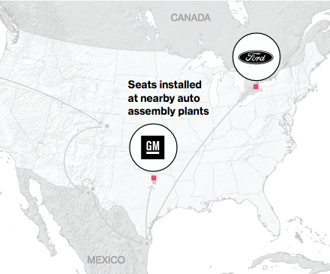
NAFTA and the Auto Supply Chain
Black, Diamond, and Merrill, “One Tiny Widget’s Dizzying Journey Shows Just How Critical Nafta Has Become,” Bloomberg, February 2, 2017.

Slide 35
NAFTA Effects
Consumers
  As always with freer trade, the ultimate beneficiaries are consumers
    Lower prices for
      Imported consumer goods
      Domestically produced goods and services that use cheaper imported inputs
    Greater variety of goods to choose from
  These gains are hard to measure
    One indicator may be the low rates of price inflation experienced under NAFTA

Slide 36
Pause for Discussion

Slide 37
  Questions
I’ve not assigned anything evaluating NAFTA, since it’s been replaced by USMCA. But what were, and are, your impressions of NAFTA?

Slide 38
USMCA
What it is
  “United States, Mexico, Canada Agreement”
  Result of Trump’s renegotiation of NAFTA
  Mostly the same as NAFTA
Why replace NAFTA?
  Trump opposed NAFTA as early as 1993
    “The Mexicans want it, and that doesn't sound good to me.”
  Opposition to NAFTA was popular

Slide 39
USMCA Timeline
Renegotiation
  May 18, 2017: Renegotiation began
  Aug 27, 2018: Agreement between US and Mexico
  Sep 30, 2018: Agreement with Canada to join
Approval and Implementation
  Dec 19, 2019: US House approved (contentious)
  Jan 17, 2020: Senate approved (expected)
  Jan 29, 2020: Trump signed into law
  Jul 1, 2020: Agreement goes into effect

Slide 40
USMCA Features
Car incentives
  ROO raised from 62.5% to 75%
  70% of steel & aluminum must come from NA
  40-45% of value added from >$16/hr labor
Dairy: Some opening of US dairy to Canada
ISDS only between US & Mexico
Commitments on labor & IP standards
“Sunset Clause” Review after 6 years
Inform US if negotiate with NME (China)
Commitment not to manipulate currencies

Slide 41
Pause for Discussion

Slide 42
  Questions
How big a change is USMCA compared to NAFTA?
What industry or product seems to have gotten the most attention in the changes made to USMCA?
Is Canada dropping its protectionist policies on dairy?
Is intellectual property protection being increased or decreased?

Slide 43
  Questions on Swanson,
  “Much Remains Undone”
USMCA included stronger rules on labor standard, particularly in Mexico. Are these going to be followed immediately?
Is there any reason why companies might not immediately follow the rules of origin that were included in USMCA?

Slide 44
  Questions on Nakayama, “Japanese carmakers …”
How are Japanese car companies responding to USMCA rules?
Can you tell from this what the tariff rate would be if cars made in Mexico don’t have 40% of value from high-wage workers?
What are companies doing to respond to the USMCA rules?
What will USMCA do to the prices of cars in the US?

Slide 45
Recent FTA News
Africa
  AfCFTA: African Continental Free Trade Area
  Came into force May 2019
  “Strips away tariffs on 90 per cent of goods”

Slide 46
Pause for Discussion

Slide 47
  Questions on AfCFTA
How many countries does AfCFTA include?
What reasons are given for trade among the member countries to be smaller than within the EU, NAFTA, etc.?
What do the countries of Africa currently mostly export, and why is this a problem according to this?

Slide 48
Recent FTA News: EU
EU and Canada
  CETA: Comprehensive Economic and Trade Agreement
  FTA between EU and Canada
  Implemented 2017
  Includes “export quotas” for agricultural products
  Includes MFN clause, relevant for EU-UK FTA

Slide 49
Recent FTA News: EU
EU and MERCOSUR (CU of Brazil, Argentina, Uruguay, & Paraguay)
  FTA “sealed” in June 2019, but not yet ratified
  Ratification was to begin in 2020
  Advantages expected:
    Access to Brazil for EU industrial goods and wine
    Access to EU for South American beef, poultry, and sugar
  Problems with ratification include:
    “decision to allow sugarcane cultivation in the Amazon region.”

Slide 50
Recent FTA News: EU
EU and Mexico
  EU & Mexico had FTA from 2001. This is to replace it.
  Features:
    Duty-free trade in almost all goods
    Measures to fight corruption and money laundering
    Investment protection,
    Sustainable development
    Simpler customs rules to boost exports.

Slide 51
Recent FTA News: EU
EU and Vietnam
  EVFTA: EU-Vietnam Free Trade Agreement
  Approved in Vietnam June 8, 2020
  Features
    Zero tariffs immediately on 65-71% of trade
    99% of other tariffs phased out over 7-10 years
  Trade is mostly textiles and apparent to EU, aircraft and cars to Vietnam
  Models predict Vietnam growth by 2030 of 2.4% in GDP and 12% in exports

Slide 52
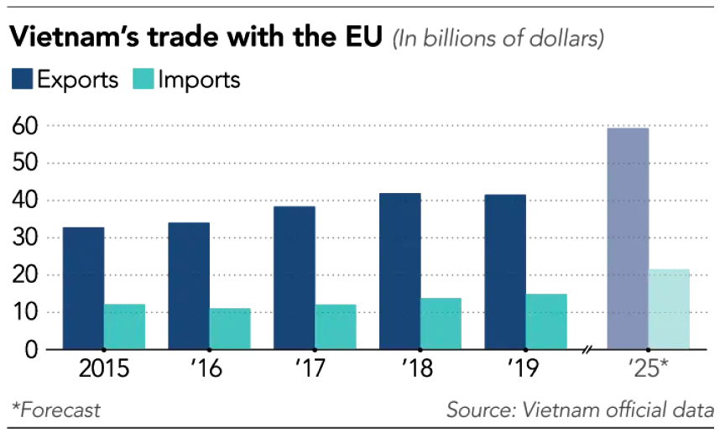
Notes:
Onishi, Tomoya, “Vietnam targets China manufacturers after EU trade green light,” Financial Times, June 17, 2020.
https://www.ft.com/content/1247172b-e777-4feb-8ed5-27ac36519c5a

Slide 53
Pause for Discussion

Slide 54
  Questions on CETA
When was Ceta implemented, and when did it go fully into effect? Why?
Which sectors have taken most advantage of Ceta in Canada, which have not, and why?
Does Ceta remove all trade barriers between Canada and the EU?
What is the importance of the “most-favoured nation clause” in Ceta?

Slide 55
  Questions on EU-MERCOSUR
Why is Brazil’s change of sugar policy opposed by the EU?
How is the EU able to use so much sugar from Brazil?
What is the “soy moratorium”?

Slide 56
  Questions on EU-Mexico
Is this new agreement in effect now?
Does it remove all tariffs?
What features are mentioned that are apparently new?

Slide 57
  Questions on EVFTA
Was EVFTA controversial?
What is the main product that Vietnam exports to the EU? Will this have zero tariff immediately?
How is trade between Vietnam and the UK affected?

Slide 58
Recent FTA News: China
RCEP
  RCEP: Regional Comprehensive Economic Partnership
  Large FTA being negotiated since 2013 by
    ASEAN 10 countries plus 5: China, Japan, South Korea, Australia and New Zealand
    India also, until it recently dropped out
  ”Bulk of negotiations” done last November
  Hope to finish by end of 2020

Slide 59
Recent FTA News: China
China and Iran (reading optional)
  Iran and China are believed to have reached agreement on an “economic and security partnership”
  Agreement covers
    Chinese operations in Iran in “banking, telecommunications, ports, railways and dozens of other projects”
    Discounted supplies of oil over the next 25 years.
    Military cooperation

Slide 60
Pause for Discussion

Slide 61
  Questions on RCEP
When did negotiations for RCEP begin, and when are they expected to conclude?
Is RCEP to be just an FTA?

Slide 62
Recent FTA News: UK
UK couldn’t do deals while still in EU, since it’s a customs union
What is hard to do in new FTAs?
  Tariffs? No
  Rules & regulations? Yes, much harder
Needs FTA with EU to replace its status as member
  Even with FTA, EU will check some imports, such as food, as it does other non-EU imports

Slide 63
Recent FTA News: UK
EU has about 40 deals with about 70 countries
Post-Brexit UK trade deals done:
  19 deals covering 50 countries, about 8% of its trade (list on next slide)
  Largest:
    Switzerland (£32.4bn of trade in 2018)
    South Korea (£14.8bn in 2018)
  Also: Japan, as of 10/23/20

Slide 64
UK Trade Deals Done
(with amount of trade)
Kosovo (£8m)
Jordan (£448m)
Morocco (£2.5bn)
Georgia (£123m)
Southern African nations (£10.2bn)
Tunisia (£542m)
Lebanon (£762m)
South Korea (£14.8bn)
Central America (£1.1bn)
Andean countries (£3.4bn)
Caribbean countries (£3.7bn)
Pacific Islands (£163m)
Liechtenstein (£146m)
Israel (£4.2bn)
Palestinian Authority (£41m)
Switzerland (£32.4bn)
The Faroe Islands (£252m)
Eastern and Southern Africa (£2bn)
Chile (£2bn)

Slide 65
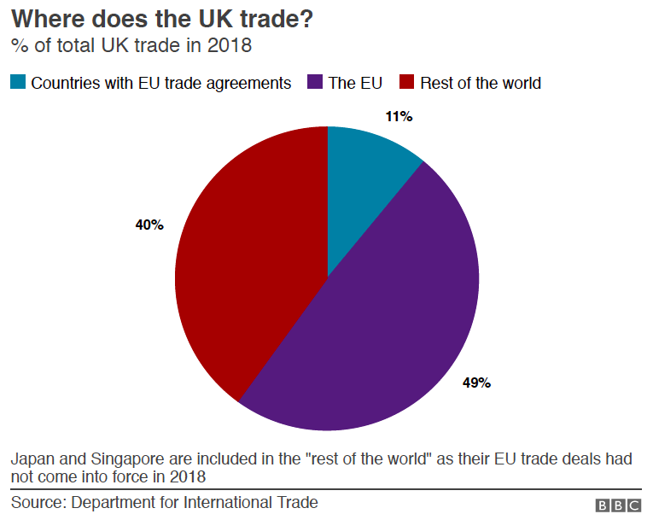
Notes:
Edgington, Tom, “Brexit: What trade deals has the UK done so far?,” BBCNews, March 2, 2020.
https://www.bbc.com/news/uk-47213842

Slide 66
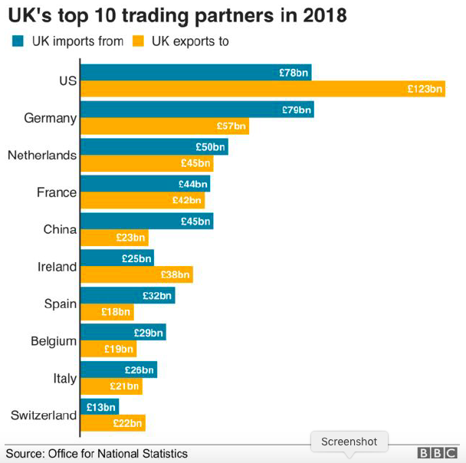
Notes:
Edgington, Tom, “Brexit: What trade deals has the UK done so far?,” BBCNews, March 2, 2020.
https://www.bbc.com/news/uk-47213842

Slide 67
Recent FTA News: UK
Japan-EU
  (Deal completed 10/23/20)
  Japan resists deal better than with EU
  UK (as of August) wanted better deal on British Stilton cheese
    Would be ”symbolic” that Brexit was worth it

Slide 68
Recent FTA News: UK
UK-US
  Talks began in May, with 30 groups
  UK benefits of deal: increase UK GDP by 0.15% over 15 years.
  Difficulties
    Uncertainty about EU-UK deal
    US election
    Farming standards: UK doesn’t want
      chlorine-washed chicken
      genetically modified crops

Slide 69
Recent FTA News: UK
UK-US (cont.) WSJ on Issues
  What are hard:
    U.K. Agricultural trade (“a needless sticking point”)
    US insistence on scientific food-safety standards
    chlorine-washed American poultry and beef treated with certain medications
    Britain’s socialized National Health Service
    U.K. imposed its version of a digital services tax on American tech giants in April
    Trump’s tariffs in the Boeing-Airbus dispute

Slide 70
Recent FTA News: UK
UK-US (cont.) WSJ on Issues
  What should be hard:
    banking regulations
    mutual recognition of professional qualifications
    reciprocal recognition of product-safety rules and inspections

Slide 71
Pause for Discussion

Slide 72
  Questions on Post-Brexit Deals
What are the main policies that a trade deal covers? Of these, which will likely be hardest to agree on between the UK and the EU?
What happens to UK if there is no deal with the EU?
Why does the UK need trade deals with non-EU countries? To what extent it is getting them?

Slide 73
  Questions on Japan-UK
Why does the UK trade secretary want a better deal on cheese exports to Japan than the EU has?

Slide 74
  Questions on UK-US
What form to negotiations take?
What is the most prominent issue that will be a UK-US FTA difficult to achieve?
Is an agreement in 2020 likely?

Slide 75
  Questions on UK-US, per WSJ
What are some of the sticking points in the UK-US negotiations that the WSJ thinks the UK is foolish to insist on?
What are the issues that they say should be addressed and are being ignores?
Is President Trump doing anything that also makes it hard, in their view?

Slide 76
Recent FTA News: US
Not including US: CPTPP = Comprehensive and Progressive Trans-Pacific Partnership
  US pulled out of TPP under Trump
  Now wants FTA with many of its members
    To undo the disadvantage of being out
US is now seeking FTAs with several CPTPP countries:
  Japan, Australia, New Zealand, Vietnam

Slide 77
Recent FTA News: US
Georgia-US
  This is probably not happening, but is advocated in a reading by Bacchus, former Congressman and also Chair of WTO Appellate Body
  Reasons given:
    Georgia deserves it
    Support for democracy
    Moral case: Georgia serves with US in Afghanistan

Slide 78
Recent FTA News: US
Kenya-US
  Feb 2020: Trump announced negotiations
  Kenya is US’s 98th largest trading partner
  But deal would be model for deals with other African countries
  Fear is that US will lose out to China and its Belt and Road Initiative
  Kenya already has preferences under AGOA, but it doesn’t cover all trade and might not be renewed.

Slide 79
Recent FTA News: US
Taiwan-US
  Aug 2020: Taiwan President wants FTA with US
  Previous attempts were stepped by Taiwan’s restrictions on imports of US beef and pork
    Stopped in 2003 due to mad cow
    Now they block them due to additives
  President seems to think this issue can be resolved

Slide 80
Pause for Discussion

Slide 81
  Questions
Why does the Trump Administration want these agreements with Japan and others?
Is the case made here for a Georgia-US FTA mostly economic or political?
How many countries in Africa now have an FTA with the US?
How quickly might an FTA with Kenya be agreed upon, and what are its chances of approval in the US once agreed?
Are US officials in favor of FTA with Taiwan?

